Slide 1
Module 2
Python Programming Fundamentals

Slide 2
Interpreter Vs Compiler

Slide 3
Interpreters Vs Compilers
•Two kinds of program translator to convert from high-level languages into low-level languages:
–Interpreters
–Compilers.
•

Slide 4
Compiler
•Compiler translates a high level program to low level completely before the program starts running.
•High-level program is called source code
Translated program is called the object code or the executable.
It does not fix the error
If no error is determined the complete source code is converted into object code(machine code)

Slide 5
Compiler
•The compiler links all the code files into a single runnable program, which is known as the exe file.
•Finally, it runs the program and generates output.

Slide 6
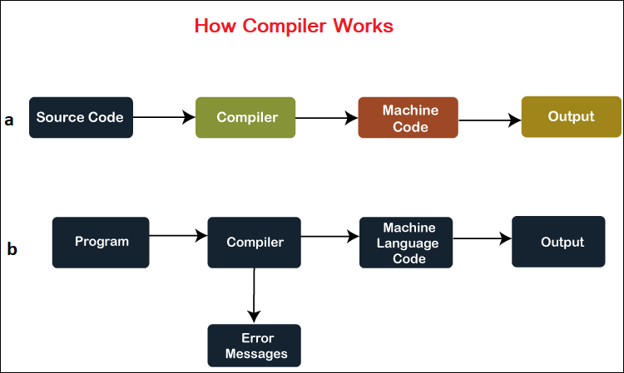

Slide 7
Interpreters
The source code programming statements are executed line-by-line during their execution.
If an error is found at any specific statement interpreter, it stops further execution until the error gets removed.
No linking of files happens, or no machine code will generate separately.

Slide 8
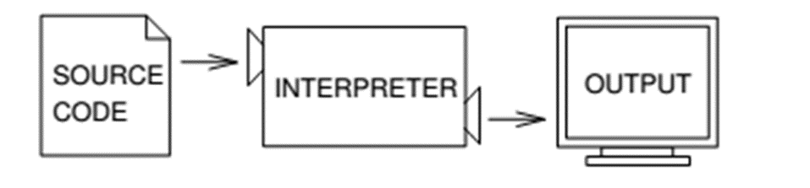
Interpreters

Slide 9
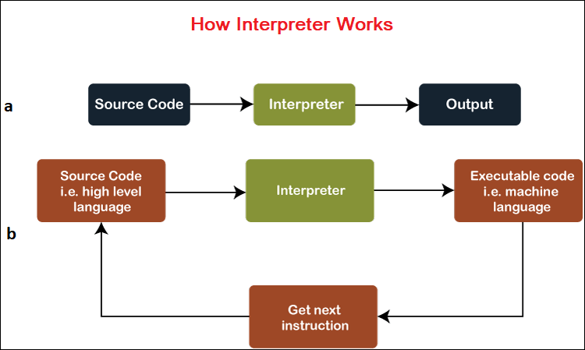

Slide 10
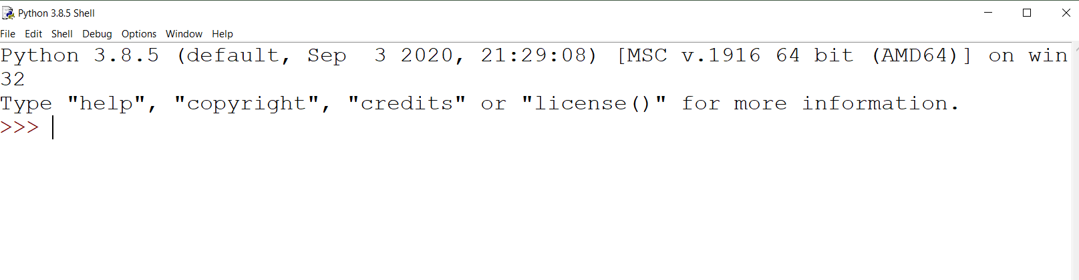
Python in idle
Displays month and year
Continuation lines

Slide 11
– Interactive and Script Mode
In Python programming, two distinct modes,
namely
Script Mode
Interactive Mode

Slide 12
Script mode:
Script Mode in Python refers to writing and executing Python scripts or programs.
It involves creating a standalone Python script file with a series of Python statements saved with the .py extension

Slide 13
Using Script Mode
Creating a Script
Saving the Script
Executing the Script

Slide 14
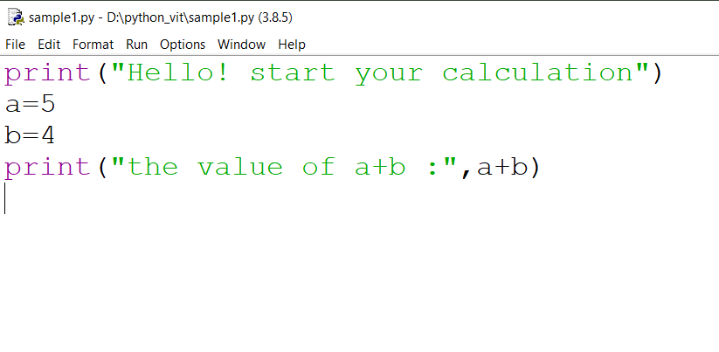
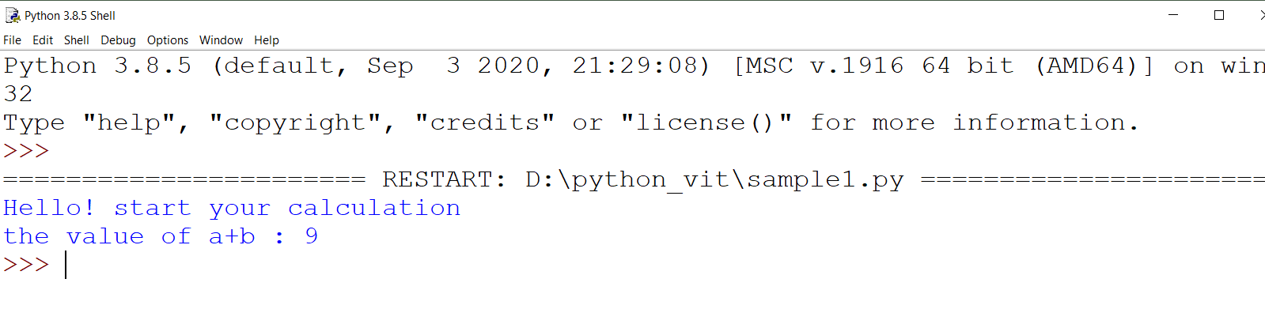
Example

Slide 15
Interactive mode
Interactive Mode in Python provides a dynamic environment for developers to interactively write and execute Python statements line by line.
It offers a way to experiment, test code snippets, and receive immediate feedback for each command entered.

Slide 16
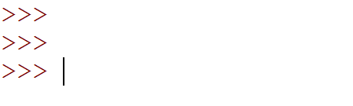
Using Interactive Mode
Accessing Interactive Mode:
entering the python command in continuation lines without specifying a script filename

Slide 17
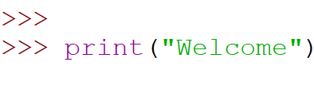
Using Interactive Mode
2. Entering Statements:

Slide 18
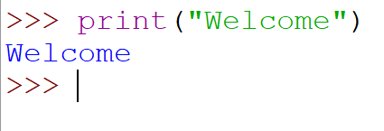
Using Interactive Mode
3. Immediate Feedback:

Slide 19
Identifiers
An identifier is a sequence of one or more characters used to name a given program element.
In Python, an identifier may contain letters (A-Z or a-z) and digits, but cannot begin with a digit.
Special underscore character can also be used
Example : line, salary, emp1, emp_salary

Slide 20
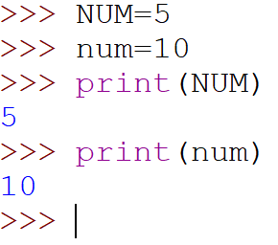
Rules for Identifier
Python is case sensitive

Slide 21
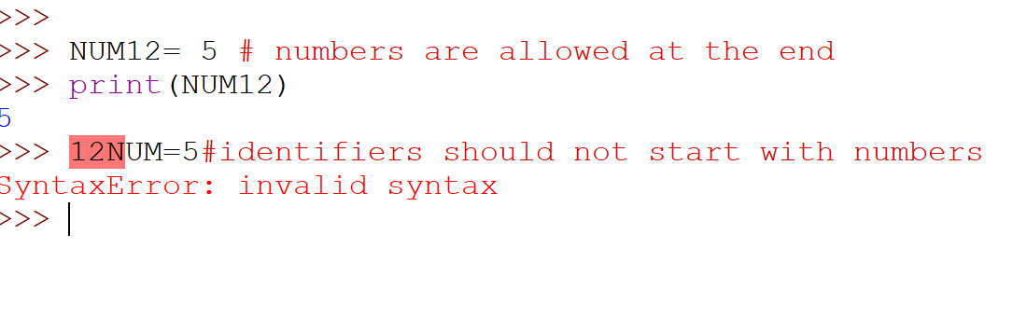
Rules for Identifier
Identifiers may contain letters and digits, but cannot begin with a digit.

Slide 22
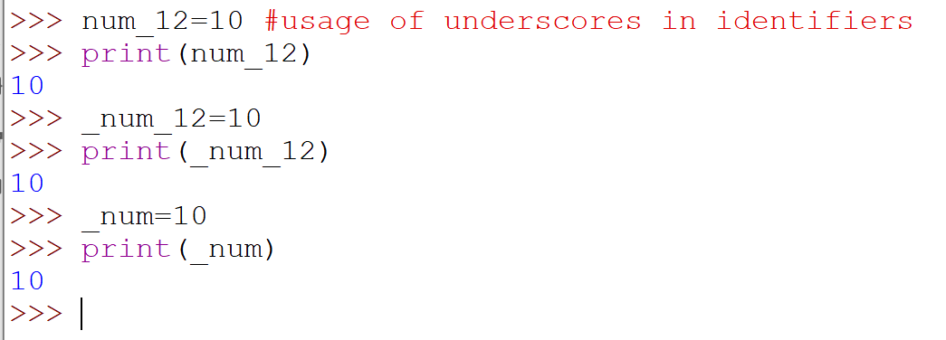
Rules for Identifier
The underscore character, _, is also allowed to aid in the readability of long identifier names.

Slide 23
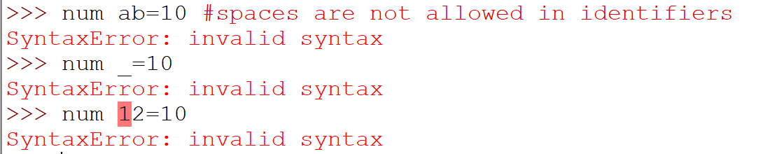
Rules for Identifier
Spaces are not allowed as part of an identifier

Slide 24
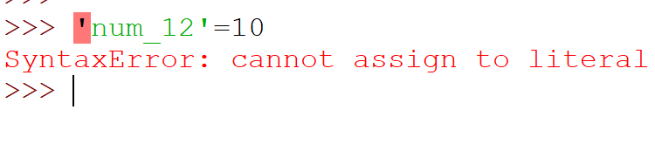
Rules for Identifier
Quotes are not allowed in identifiers

Slide 25
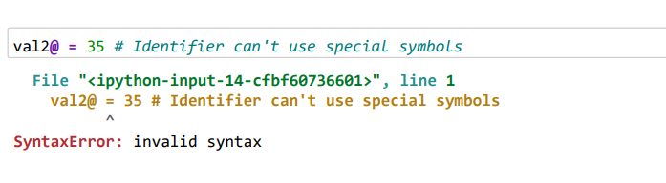
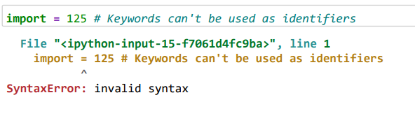
Rules for Identifier

Slide 26
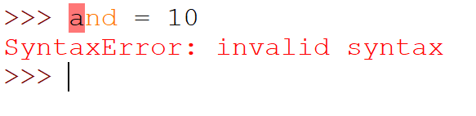
Keywords
Keywords are the reserved words in Python and can't be used as an identifier.
A keyword is an identifier that has pre-defined meaning in a programming language.

Slide 27
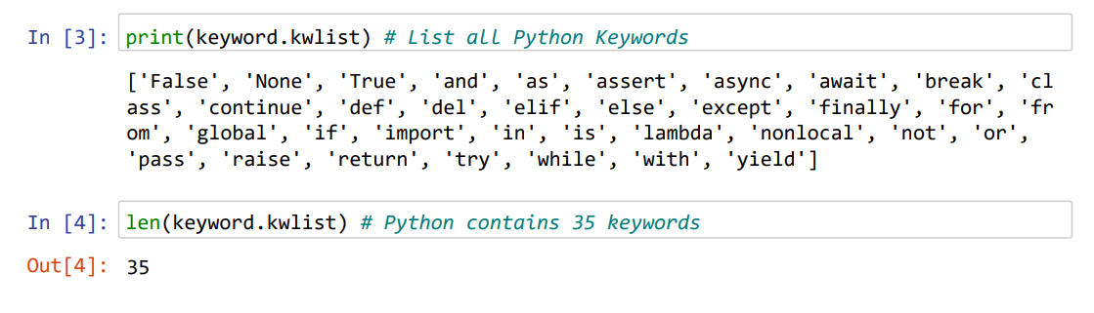
keywords
The read-only attribute kwlist returns a list of all keywords reserved for the interpreter

Slide 28
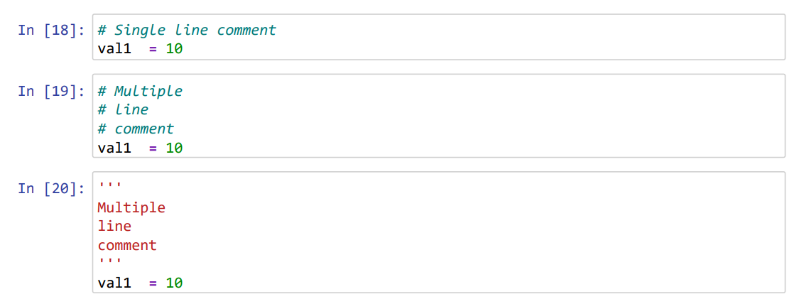
Comments in Python

Slide 29
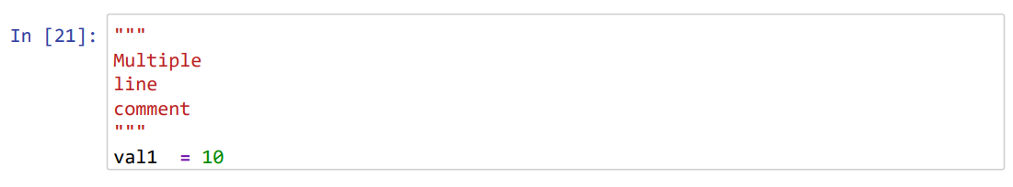
Comments in Python

Slide 30
Indentation
Most of the programming languages like C, C++, and Java use braces { } to define a block of code.
Python, however, uses indentation.

Slide 31
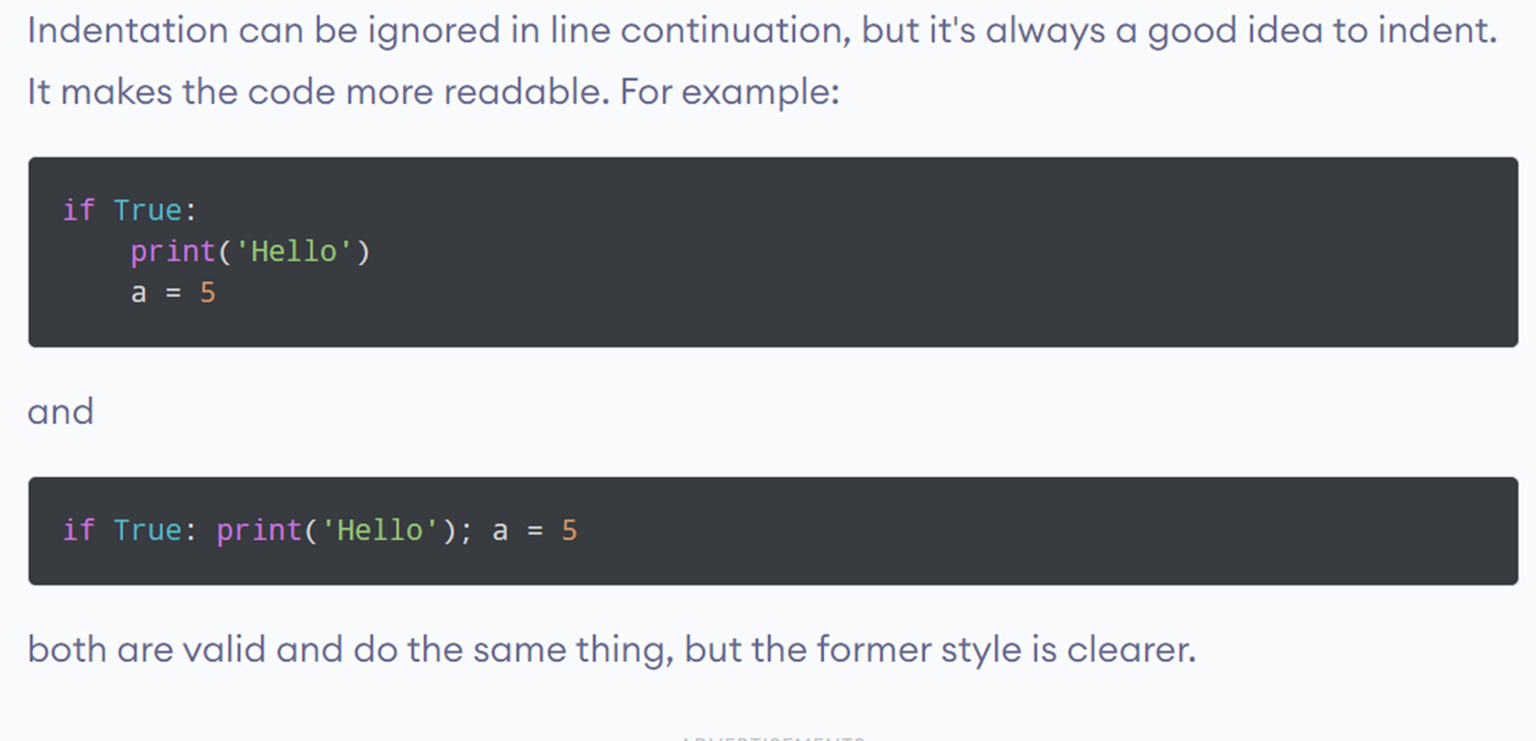
Indentation

Slide 32
Input function()
>>> print("What is your name?")
What is your name?
In the print function, the output is printed and the stops execution
>>> input("What is your name?")
What is your name?George
'George’
In the input function, the prompt is printed and waits till it receives data.

Slide 33
Input()
•Concatenation of print and input function
•>>> print("Hello "+input("What is your name?"))
•What is your name?George
•Hello George

Slide 34
Practice: Read two numbers from users and print the result
num1=int(input())
num2=int(input())
print(num1*num2)
Result: 5
5
25… Answer

Slide 35
Variables
A variable is a named location (identifier) used to store data in the memory.
It is helpful to think of variables as a container that holds data that can be changed later in the program.
Variables are assigned with values by use of the assignment operator

Slide 36
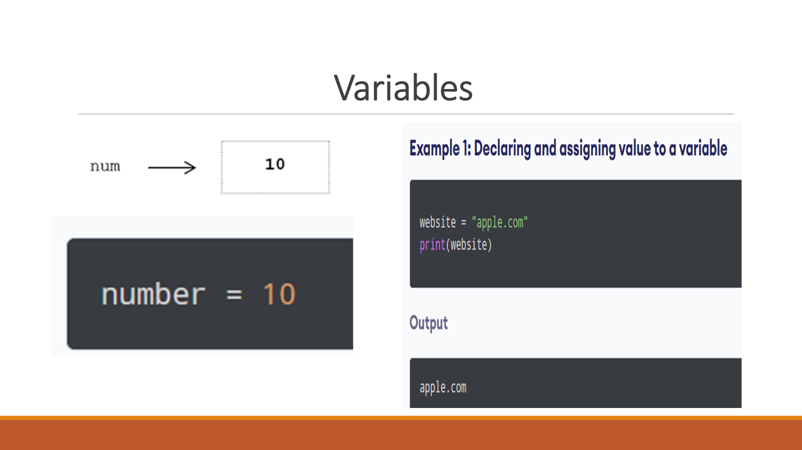

Slide 37
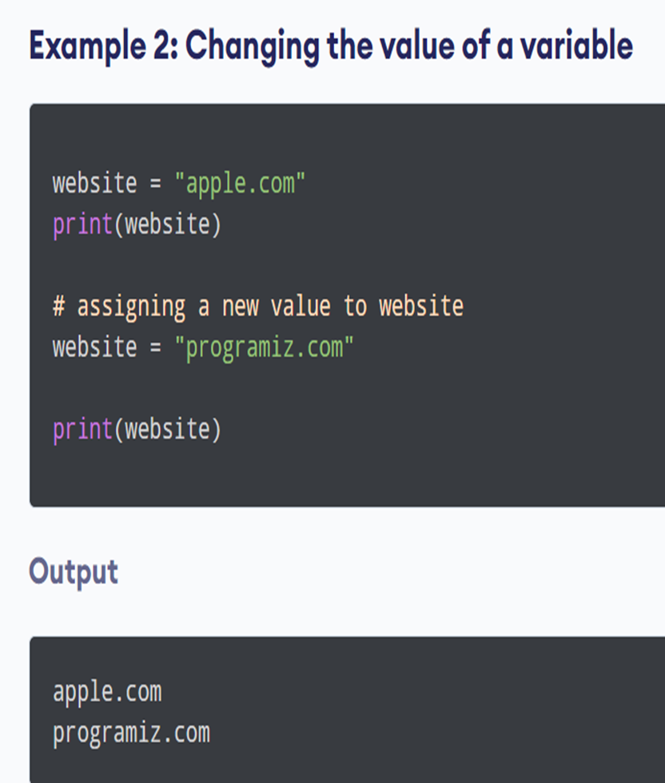

Slide 38
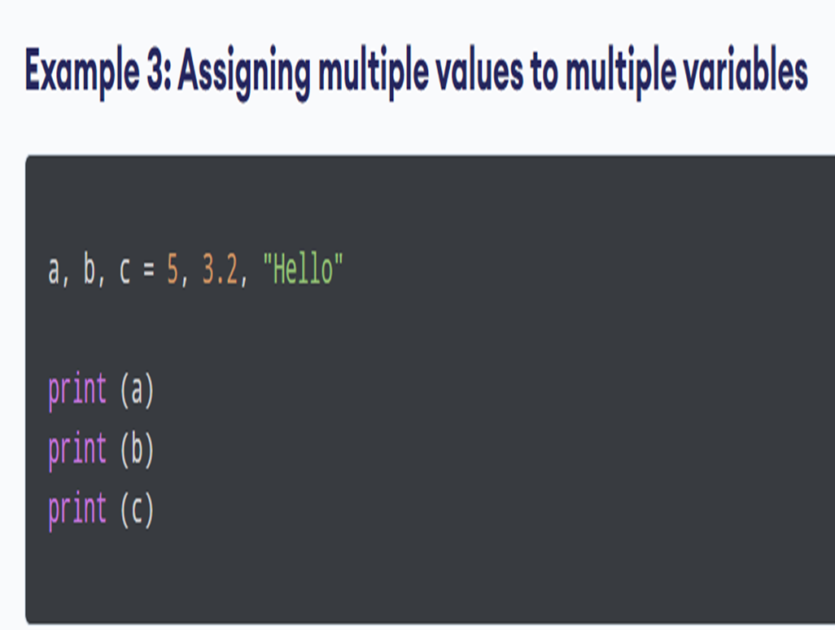
What is the expected output ??

Slide 39
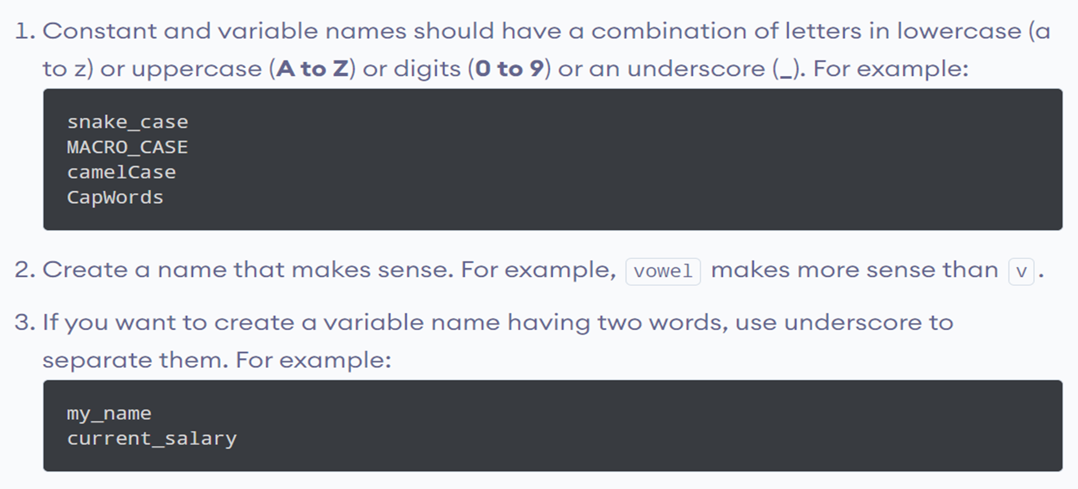
Rules and Naming Convention for Variables and Constants

Slide 40
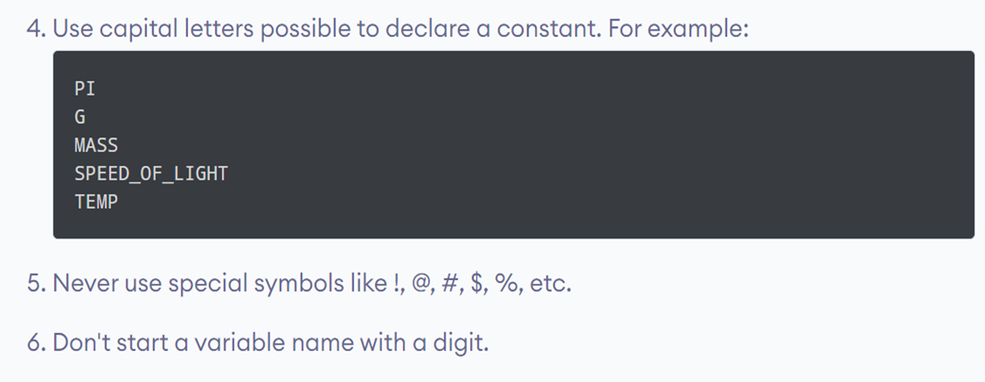
Rules and Naming Convention for Variables and Constants

Slide 41
Variables
input("What is your name?")
Result:
What is your name?George
print(input("What is your name?"))
Result:
What is your name?George
George
print(len(input("What is your name?")))
Result:
What is your name?George
6

Slide 42

How do you include a variable for the last slide??
name=input("what is your name?")
length=len(name)
print(length)
Result:
what is your name?George
6
name=input("what is your name?\n")
length=len(name)
print(length)
Result:
what is your name?
George
6

Slide 43
Variables
Code:
a=input()
b=input()
c=a
a=b
b=c
print("a:"+a)
print("b:",b)
Result
Input:
Hello
world
Output:
a:world
b: Hello

Slide 44
Practice
#1. Create a greeting for your program.
#2. Ask the user for the place that they most love to settle.
#3. Ask the user for the name of a city to which they have traveled.
#4. Combine the name of their place and city and show them their Startup Company name .
#5. Make sure the input cursor shows on a new line:

Slide 45
Answer
#1. Create a greeting for your program.
print("Welcome to the Startup Company name generator\n")
#2. Ask the user for the place that they most love to settle.
place=input("Which city you love to settle?\n")
#3. Ask the user for the name of a city to which they have traveled.
city=input("What is the name of a city to which you have traveled?\n")
#4. Combine the name of their place and city and show them their Startup
Company name .print("Your Startup Company name could be "+place+" "+city ,"\n")
#5. Make sure the input cursor shows on a new line:

Slide 46
Data types
Data types supported by Python
Numeric Types
Sequence Types
Set Types
Mapping Types
Binary Types
None Type

Slide 47
Numeric Types
Integer (int): Represents whole numbers. Example: 42, -7, 0
Floating-point (float): Represents real numbers with a decimal point. Example: 3.14, -0.001, 2.0
Complex (complex): Represents complex numbers with real and imaginary parts. Example: 2 + 3j, -1.5 + 0.5j

Slide 48
Numeric Types
Boolean (bool): Represents truth values True and False. Example: True, False
Fraction (fractions.Fraction): Represents rational numbers as fractions. Example: Fraction(1, 3), Fraction(2, 5)

Slide 49
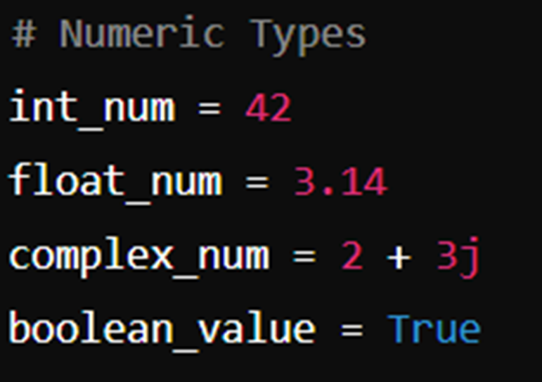
Examples

Slide 50
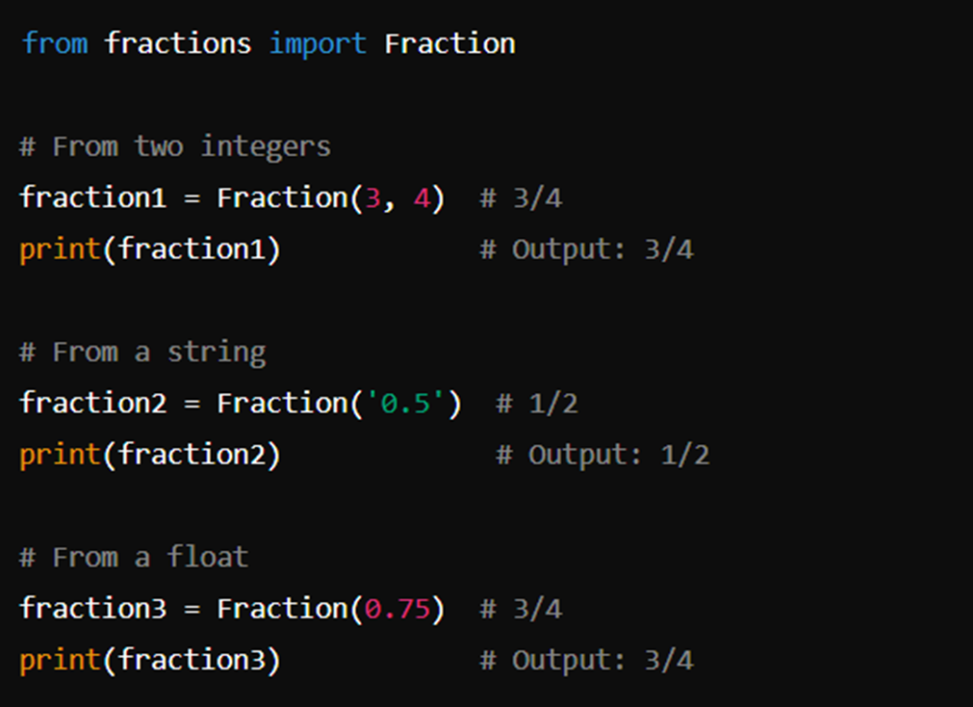
Fraction

Slide 51
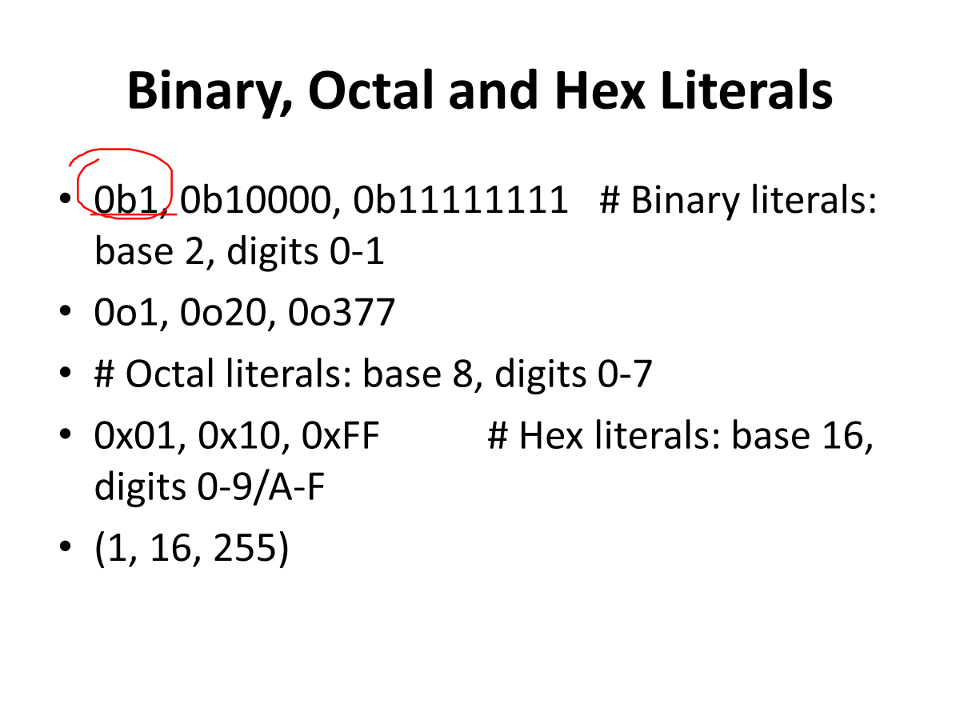

Slide 52
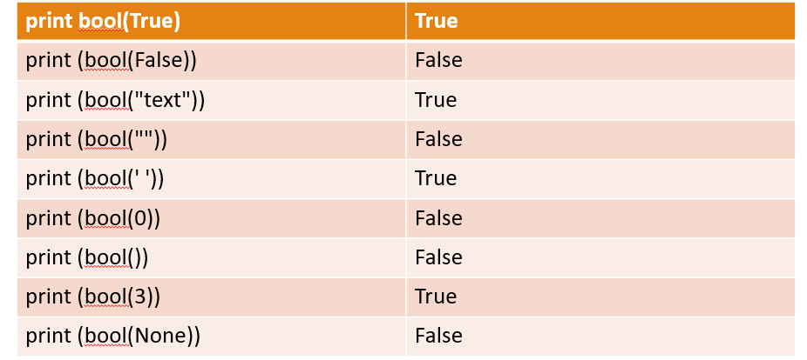
Boolean values
Primitive datatype having one of two values: True or False

Slide 53
2. Sequence Types (Note : all these are ordered)
String (str): Represents sequences of characters. Example: "hello", 'world’
List (list): Represents ordered, mutable sequences of elements. Example: [1, 2, 3], ['a', 'b', 'c’]. Lists can store multiple values but string will store multiple characters.
Tuple (tuple): Represents ordered, immutable sequences of elements. Example: (1, 2, 3), ('a', 'b', 'c’)
Range (range): Represents sequences of numbers, commonly used in loops. Example: range(10), range(1, 10, 2)

Slide 54
Strings
Strings in Python are identified as a set of characters represented in quotation marks.
Python allows for either pair of single or double quotes.
Strings are immutable

Slide 55
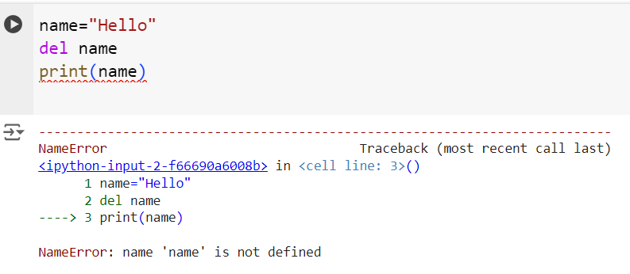
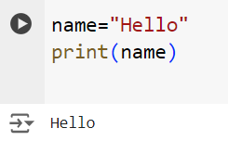
Strings
We cannot delete or remove characters from a string. But you can delete the entire string using ‘del’ keyword.

Slide 56
Strings
Subsets of strings can be taken using the slice operator ([ ] and [:] ) with indexes starting at 0 in the beginning of the string and working their way from -1 at the end.
plus (+) sign is the string concatenation operator
asterisk (*) is the repetition operator

Slide 57
String exercise
name="Welcome to the Python lab"
print (name)
print(name[0])
print(name[-1])
print(name[2:5])
print(name[2:])
print(name[:9])
print(name[:-1])
print(name * 2)
print(name + "Text")
Welcome to the Python lab
W
b
lco
lcome to the Python lab
Welcome t
Welcome to the Python la
Welcome to the Python labWelcome to the Python lab
Welcome to the Python labText

Slide 58
str=“Hello World!”
print (str)
print (str[0])
print (str[3:6])
print (str [3: ])
print(str[-1])
print (str[ :-1])
print str * 4
print str+ “TEST”

Slide 59
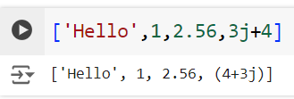
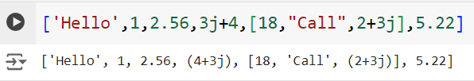
Lists
Lists store multiple values separated with a comma.
Lists can have any data types as values in it.

Slide 60
Tuples
Tuple is similar to List except that the objects in tuple are immutable which means we cannot change the elements of a tuple once assigned.
When we do not want to change the data over time, tuple is a preferred data type

Slide 61
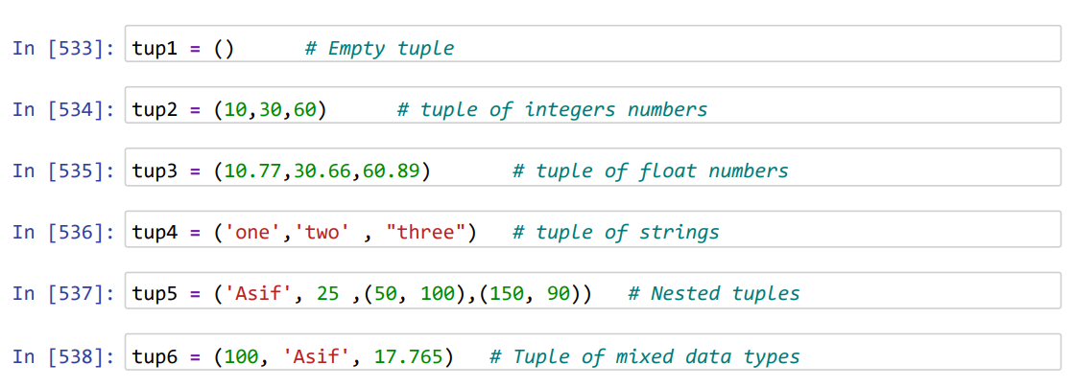
Tuple

Slide 62
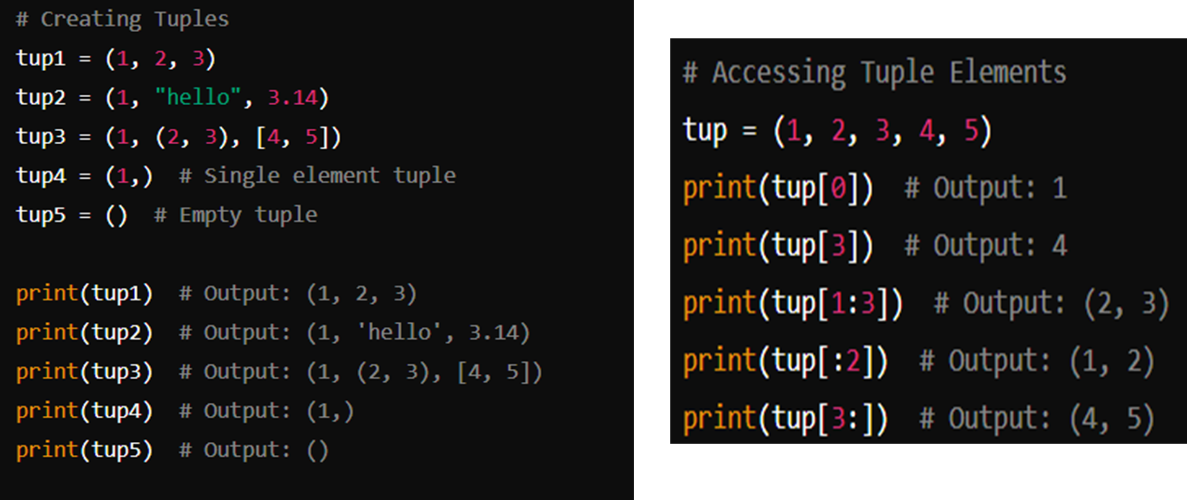

Slide 63
Range
The range function in Python is used to generate a sequence of numbers.
It is commonly used in loops to iterate over a sequence of numbers.
The range function can be used in several ways depending on the number of arguments provided.
Syntax
1. range(stop)
2. range(start, stop)
3. range(start, stop, step)

Slide 64
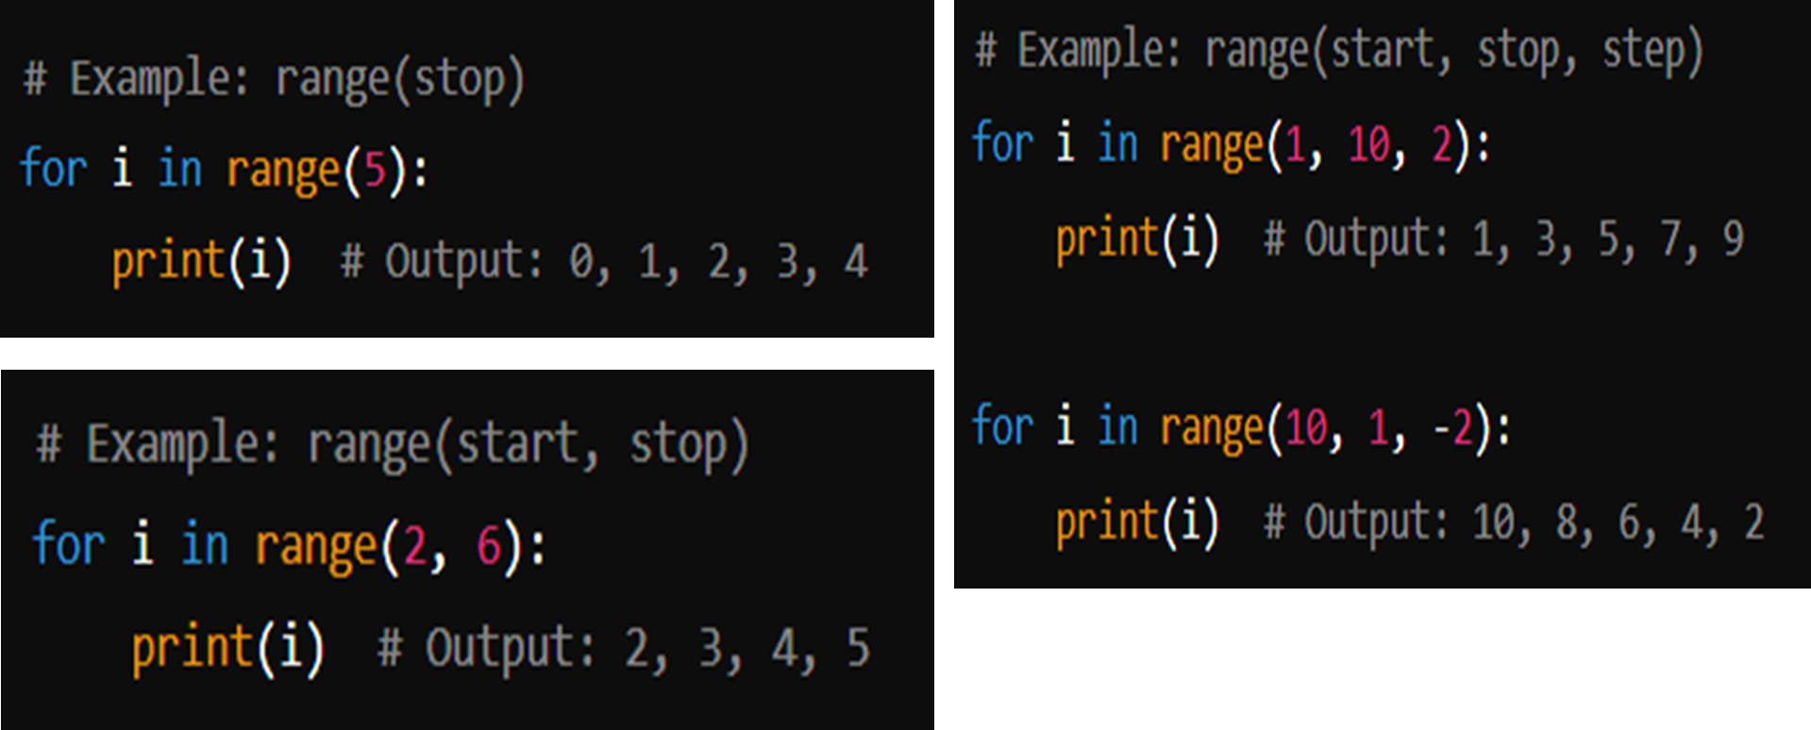

Slide 65
3. Set
Unordered & Unindexed collection of items.
2) Set elements are unique. Duplicate elements are not allowed. Application : in statistical analysis
3) A set is a collection which is unordered, unchangeable*, and unindexed.
4) FrozenSet elements are immutable (cannot be changed)
* Note: Set items are unchangeable, but you can remove items and add new items.

Slide 66
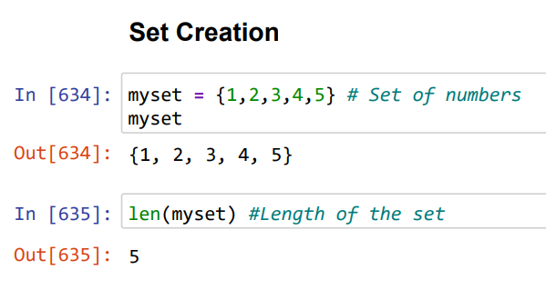
3. Set
Unordered & Unindexed collection of items.
2) Set elements are unique. Duplicate elements are not allowed. Application : in statistical analysis
3) Set elements are immutable (cannot be changed)

Slide 67
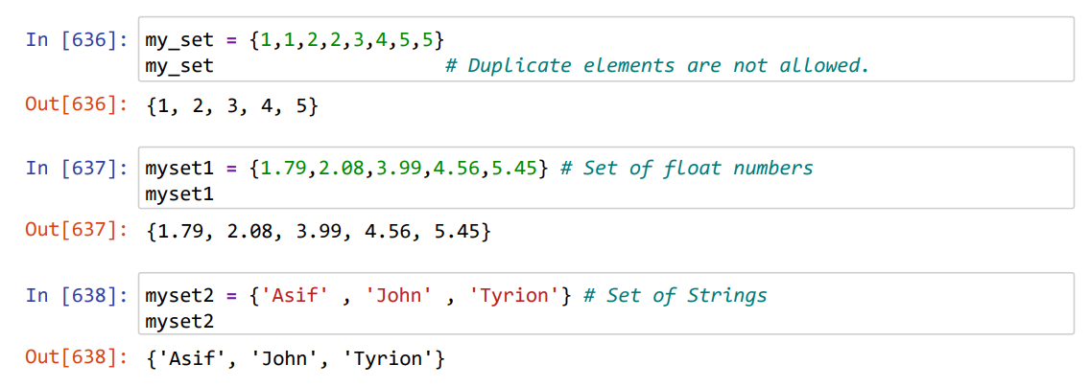
Set

Slide 68
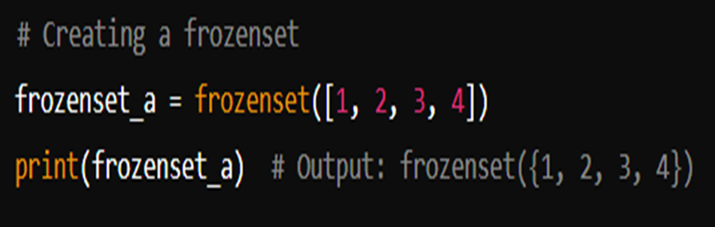
Frozen set

Slide 69
Try this
thisset = {"apple", "banana", "cherry", True, 1, 2}
print(thisset)
thisset = {"apple", "banana", "cherry", False, True, 0}
print(thisset)

Slide 70
4. Mapping data type
Dictionary (dict): Represents collections of key-value pairs.
Example: {'a': 1, 'b': 2}, {1: 'one', 2: 'two’}

Slide 71
Dictionary
Python's dictionaries consist of key-value pairs
A dictionary key can be almost any Python type, but are usually numbers or strings.
Dictionaries are enclosed by curly braces ({ }) and values can be assigned and accessed using square braces ([]).
The values of the dictionary can be changed.
A dictionary is a collection which is ordered*, changeable and do not allow duplicates.
Note: As of Python version 3.7, dictionaries are ordered. In Python 3.6 and earlier, dictionaries are unordered.
Dictionaries cannot have two items with the same key:.

Slide 72
Practice
thisdict = {
"brand": "Ford",
"model": "Mustang",
"year": 1964
}
print(thisdict)
print(thisdict["brand"])
{'brand': 'Ford', 'model': 'Mustang', 'year': 1964}
Ford

Slide 73
Duplicate values will overwrite existing values:
thisdict = {
"brand": "Ford",
"model": "Mustang",
"year": 1964,
"year": 2020
}
print(thisdict)
{'brand': 'Ford', 'model': 'Mustang', 'year': 2020}
Note: The values in dictionary items can be of any data type:

Slide 74
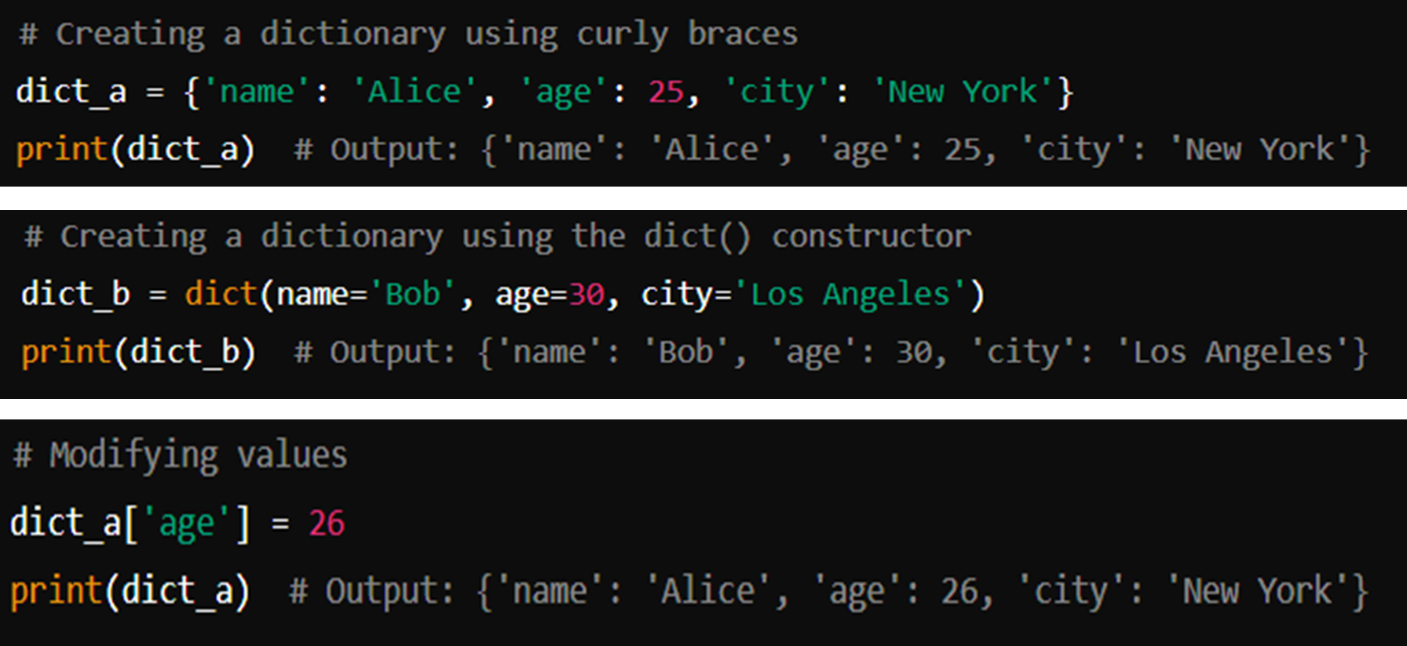

Slide 75
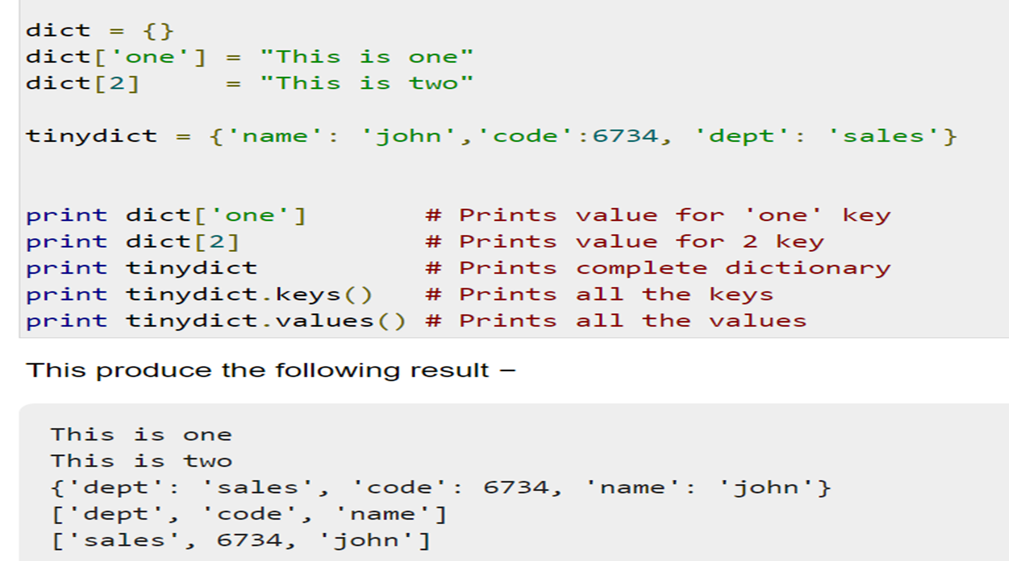

Slide 76
5. None data type
Special data type - None
Basically, the data type means non existent, not known or empty
Can be used to check for emptiness

Slide 77
None data type
def check_return():
pass
print(check_return())
Result: None

Slide 78
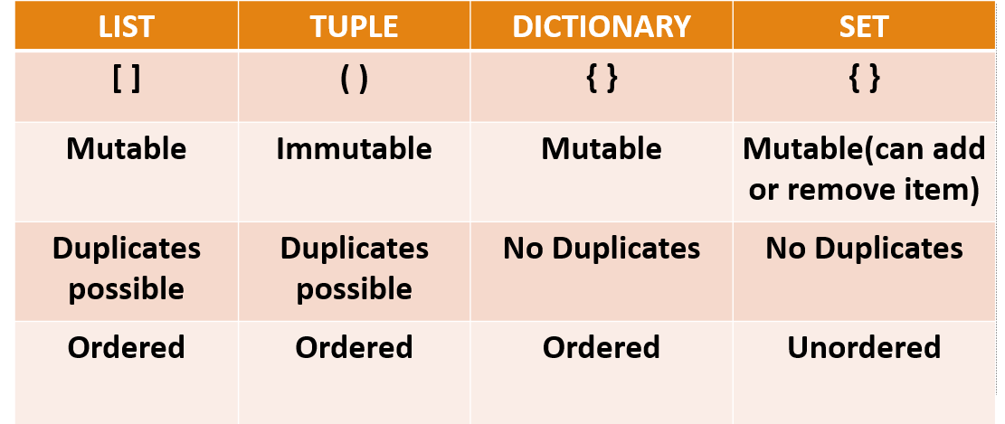
List, tuples, dictionary

Slide 79
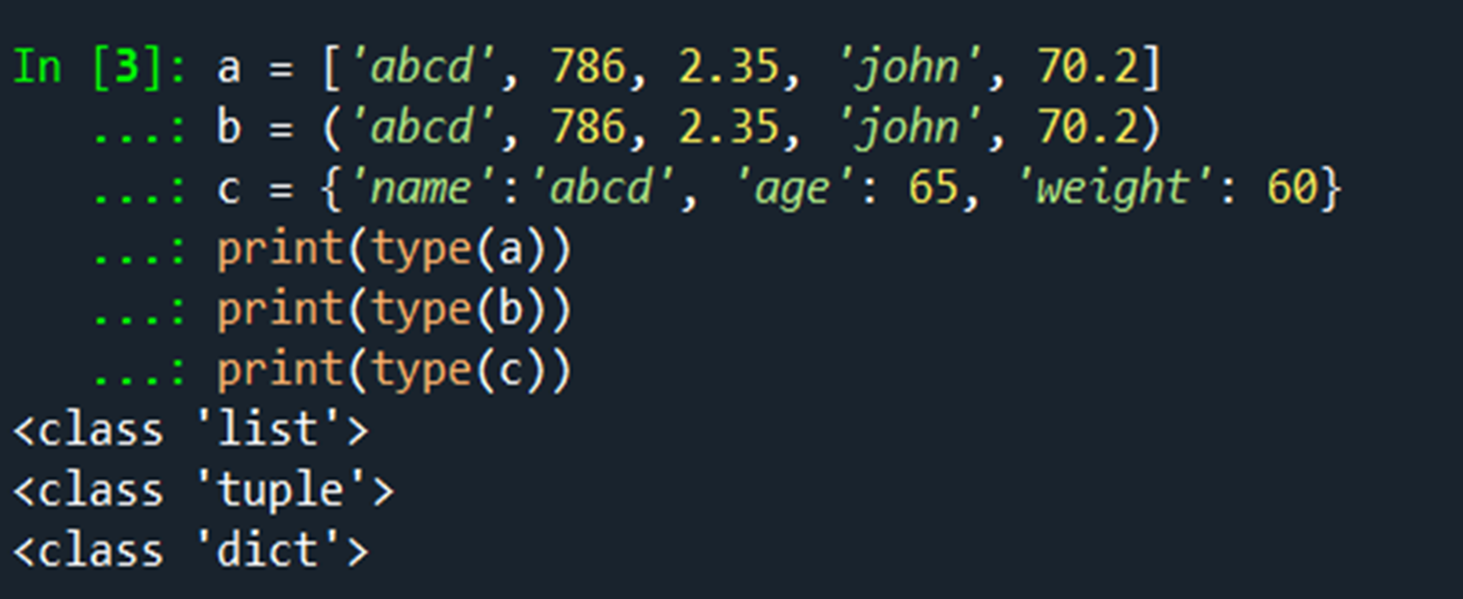

Slide 80
Operators
Operators are special symbols in Python which are used to perform operations on variables/values.
Arithmetic operators
Ternary operator
Relational operators
Assignment operators
Logical operators
Bitwise operators
Special operators

Slide 81
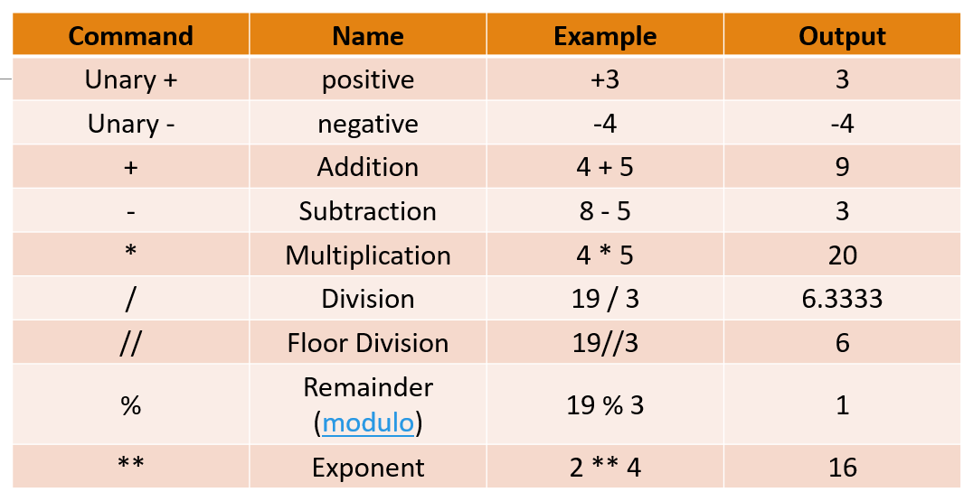
Arithmetic operators

Slide 82
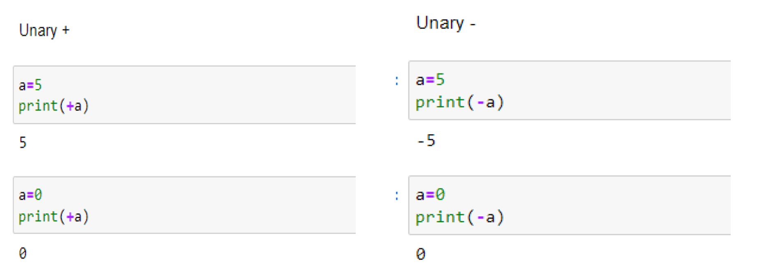
Arithmetic operators

Slide 83
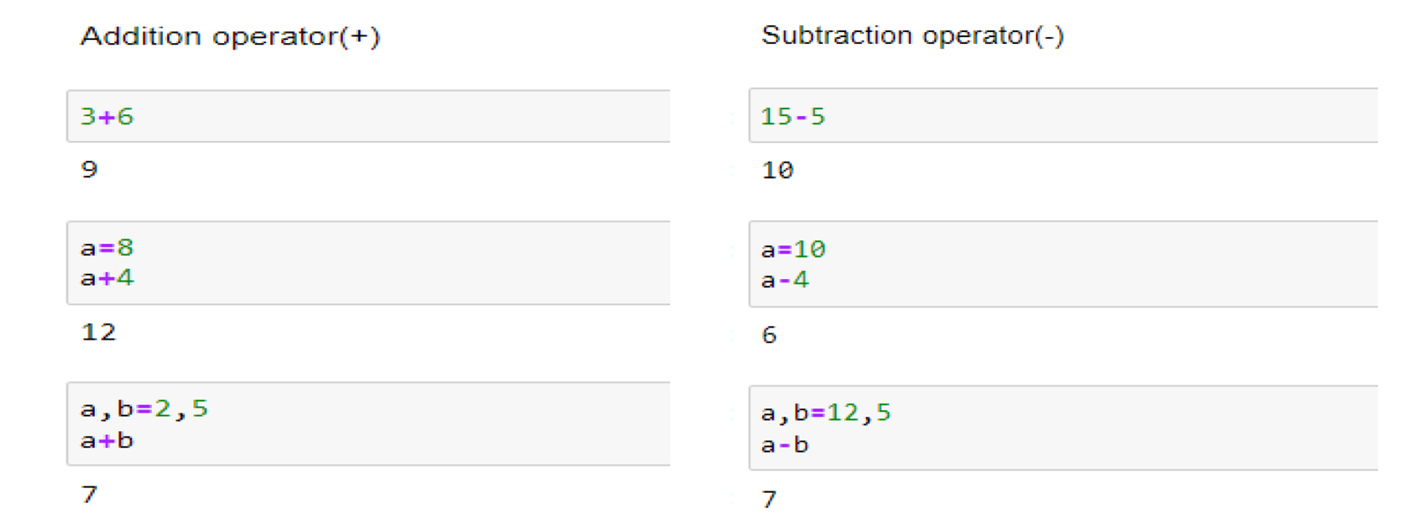
Arithmetic operators

Slide 84
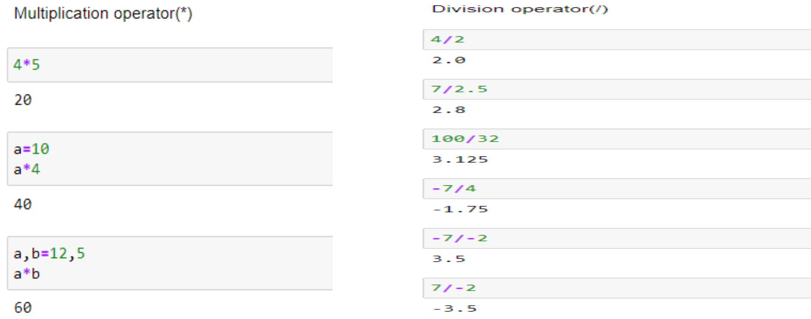
Arithmetic operators

Slide 85
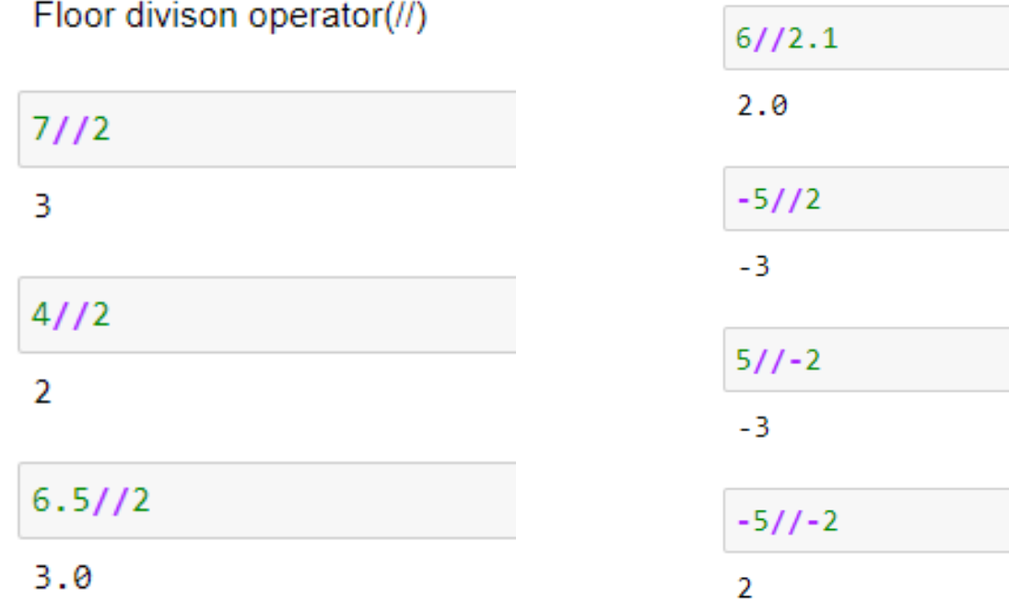
Arithmetic operators

Slide 86
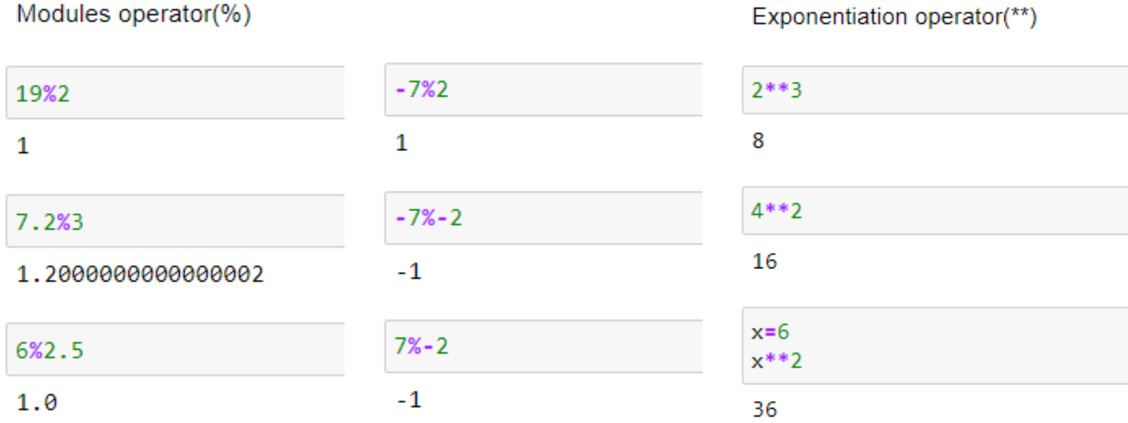
Arithmetic operators

Slide 87

Ternary operators
These are operators that test a condition and, based on that, evaluate a value.

Slide 88

Relational operator

Slide 89


Slide 90

Assignment operator

Slide 91
Logical operators
Logical operators are used on conditional statements (either True or False). They perform Logical AND, Logical OR and Logical NOT operations.

Slide 92

Logical operators

Slide 93


Slide 94


Slide 95


Slide 96

Precedence of logical operators

Slide 97
Bitwise operator
Refers to the operators working on a bit

Slide 98

Bitwise operator

Slide 99



Slide 100


Slide 101

Precedence of Operators

Slide 102
Special operators
Special operators provide additional functionality to perform specific tasks or comparisons in a more specialized manner.
Identity operator

Slide 103
Identity operator
The identity operators in Python are used to compare the identity of two objects, which means they check whether two objects refer to the same memory location.
is
is not

Slide 104
“is” identity operator
The "is" operator returns True if two objects have the same identity, indicating that they are the same object.
It compares the memory addresses of the objects rather than their values.
If the objects have different memory addresses, even if their values are the same, the "is" operator will return False.
Syntax: object1 is object2

Slide 105
“is not" operator
The "is not" operator returns True if two objects have different identities, indicating that they are not the same object.
It is the negation of the "is" operator.
Syntax: object1 is not object2

Slide 106
Example
x1 = 5
y1 = 5
x2 = 'Hello'
y2 = 'Hello'
x3 = [1,2,3]
y3 = [1,2,3]
print(x1 is not y1)
print(x2 is y2)
print(x3 is y3)
False
True
False

Slide 107
Membership Operators
Membership operators are used to check the membership of a value in a sequence or collection, such as strings, lists, tuples, or sets. The membership operators available in Python are "in" and "not in".
"in" operator:
The "in" operator returns True if a value is found in the given sequence or collection.
It checks whether the value is present within the sequence and returns True if it is, and False otherwise.

Slide 108
Membership Operators
"not in" operator:
The "not in" operator returns True if a value is not found in the given sequence or collection.
It checks whether the value is absent within the sequence and returns True if it is, and False otherwise.

Slide 109
message = 'Hello world'
dict1 = {1:'a', 2:'b'}
# check if 'H' is present in message string
print('H' in message) # prints True
# check if 'hello' is present in message string
print('hello' not in message) # prints True
# check if '1' key is present in dict1
print(1 in dict1) # prints True
# check if 'a' key is present in dict1
print('a' in dict1) # prints False

Slide 110


Slide 111
Built-in functions

Slide 112
COMMON BUILT-IN FUNCTIONS
Basic Functions
print(): Prints the specified message to the screen.
print("Hello, World!")
type(): Returns the type of an object.
print(type(5)) # Output: <class 'int’>\

Slide 113
COMMON BUILT-IN FUNCTIONS
id(): Returns the unique identifier (memory address) of an object.
a = 10 print(id(a))

Slide 114
COMMON BUILT-IN FUNCTIONS
Numeric Functions
abs(): Returns the absolute value of a number.
print(abs(-5)) # Output: 5
round(): Rounds a floating-point number to the nearest integer.
print(round(4.6)) # Output: 5
max(): Returns the largest item in an iterable or the largest of two or more arguments.
print(max(1, 2, 3)) # Output: 3

Slide 115
COMMON BUILT-IN FUNCTIONS
min(): Returns the smallest item in an iterable or the smallest of two or more arguments.
print(min(1, 2, 3)) # Output: 1
sum(): Sums the items of an iterable.
print(sum([1, 2, 3])) # Output: 6

Slide 116
COMMON BUILT-IN FUNCTIONS
complex(): Returns a complex number by specifying a real and an imaginary number.
complex(3,5)
(3+5j)
pow(): Returns value of X to the power of y (xy)
pow(3,4) # Output: 81

Slide 117
COMMON BUILT-IN FUNCTIONS
Sequence Functions
len(): Returns the number of items in an object.
print(len("hello")) # Output: 5
sorted(): Returns a sorted list of the specified iterable.
print(sorted([3, 1, 2])) # Output: [1, 2, 3]
reversed(): Returns a reverse iterator.
for i in reversed([1, 2, 3]):
print(i) # Output: 3 2 1

Slide 118
COMMON BUILT-IN FUNCTIONS
Sequence Functions
chr(): Returns a character for an ascii value.
print(chr(65)) # Output:A
ord(): Returns an integer that represents a Unicode point for a given Unicode character. This is complementary to char().
print(ord(‘A’))# Output: 65

Slide 119


Slide 120


Slide 121


Slide 122
TYPE Conversion
Python int()
Python float()
Python str()
Python bool()
Python type() and
Python isinstance() # Checks if an object is an instance of a particular type or class.

Slide 123
# Initialize variables
a = "123" # a is a string
b = 45.67 # b is a float
c = True # c is a boolean
# Convert string to integer
int_a = int(a)
print("int(a):", int_a, " | Type:", type(int_a))
# Convert float to integer
int_b = int(b)
print("int(b):", int_b, " | Type:", type(int_b))
# Convert integer to float
float_a = float(int_a)
print("float(int_a):", float_a, " | Type:", type(float_a))
# Convert integer to string
str_b = str(int_b)
print("str(int_b):", str_b, " | Type:", type(str_b))
# Convert integer to boolean
bool_a = bool(int_a)
print("bool(int_a):", bool_a, " | Type:", type(bool_a))
# Check the type of c
print("type(c):", type(c))
# Check if b is an instance of float
is_float = isinstance(b, float)
print("isinstance(b, float):", is_float)

Slide 124
Import Module in Python
import math
print(math.pi)
print(math.sqrt(4))

Slide 125
Example
Exercise 1: Simple Interest Calculation
Problem: Write a Python program to calculate the simple interest given the principal amount, rate of interest, and time period.
Formula: Simple Interest SI=P×R×T/100

Slide 126
# Prompt the user to enter the principal amount, rate of interest, and time period
principal = float(input("Enter the principal amount: "))
rate = float(input("Enter the rate of interest: "))
time = float(input("Enter the time period in years: "))
# Calculate simple interest
simple_interest = (principal * rate * time) / 100
# Print the result
print("The Simple Interest is:", simple_interest)

Slide 127
Example 2:
Write a Python program to calculate the compound interest given the principal amount, rate of interest, time period, and number of times the interest is compounded per year.

Slide 128

A = amount
P = principal
r = rate of interest
n = number of times interest is compounded per year
t = time (in years)

Slide 129
# Prompt the user to enter the principal amount, rate of interest, time period, and number of times interest is compounded per year
principal = float(input("Enter the principal amount: "))
rate = float(input("Enter the annual rate of interest: "))
time = float(input("Enter the time period in years: "))
n = int(input("Enter the number of times interest is compounded per year: "))
# Calculate the compound interest
amount = principal * (1 + (rate / (n * 100))) ** (n * time)
compound_interest = amount - principal
# Print the result
print("The Compound Interest is:", compound_interest)
print("The Amount after interest is:", amount)

